Slide 1
Hackathon 2014

Slide 2

It’s May 29th, 2020.
After months of waiting it’s finally out for online streaming.
You missed this phenomenal film in theatres but after much delay, your salvation has come at last.
Mark’s Big Day. The first major motion picture produced, directed, and staring the Mark Dankberg.

Slide 3
You know that this critically acclaimed masterpiece deserves nothing less than 4k video quality.
You go online, take a deep breath, and click download.
Life is perfect

Slide 4
Unfortunately the file is 100GB and it would take you almost 20 hours to download it.
On top of that it would use up all your internet for the next two months.
If only there was a way for you to watch it…
With Exede Group Downloads, you can.

Slide 5
Exede Group Downloads
Provides an easy way for you to download and watch Mark’s Big Day in a reasonable amount of time and for fraction of the 100GB

Slide 6
How it works
Satellite Infrastructure
When the satellite sends a signal to your house, it gets broadcasts to everyone on the beam.
Beams contain 10-20k.

Slide 7
Group Downloads Premise
Syncing customer downloads
Multiple customers downloading the same file.
Satellite can increase download speed since its providing a signal for several customers.
It also shares the bandwidth across everyone.

Slide 8
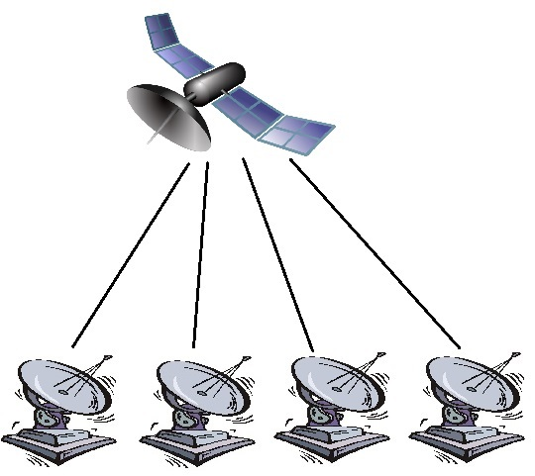
In Action, not Synced
Four people downloading Marks Big Day
Bandwidth Charged: 100GB
Speed: 12Mb/s
Time: 18 Hours

Slide 9
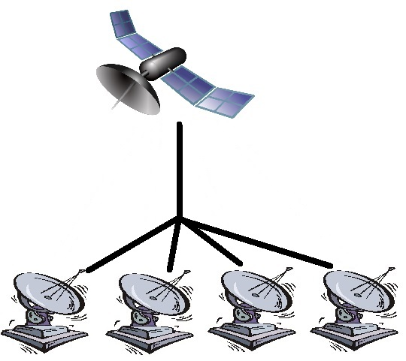
In Action, Synced
Four people downloading Marks Big Day
Bandwidth Charged: 25GB
Speed: 48Mb/s
Time: 4.5 Hours

Slide 10
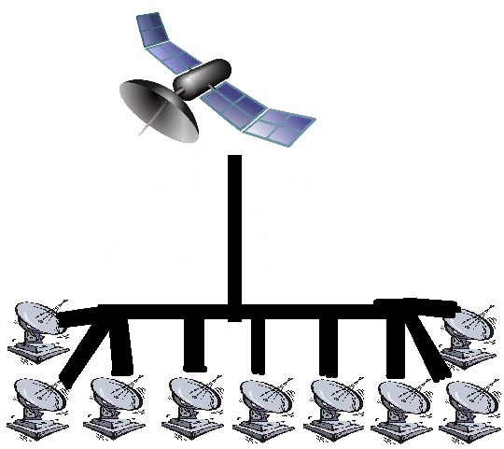
In Action, Synced
Ten people downloading Marks Big Day
Bandwidth Charged: 10GB
Speed: 120Mb/s
Time: 2 Hours

Slide 11
Benefits

Slide 12
What will the internet look like in 2020?
4k videos
Large Game files

Slide 13
What Customers will want
Faster Downloads
Higher Datacaps

Slide 14
Pingable PingBot Plan
Let Customers Download Faster
Let Customers Download More

Slide 15
How it works

Slide 16
Satellite Infrastructure
When a satellite broadcasts to a home, every dish in the beam gets the signal.
Beams Contain 10-20k people.

Slide 17
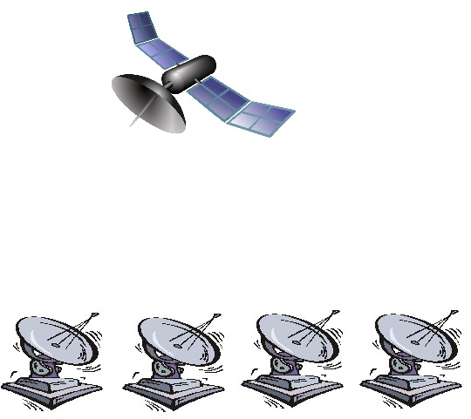
In Action, not Synced
Four people downloading Marks Big Day
Bandwidth Charged: 100GB
Speed: 12Mb/s
Time: 18 Hours

Slide 18
In Action, Synced
Four people downloading Marks Big Day
Bandwidth Charged: 25GB
Speed: 48Mb/s
Time: 4.5 Hours

Slide 19
In Action, Synced
Ten people downloading Marks Big Day
Bandwidth Charged: 10GB
Speed: 120Mb/s
Time: 2 Hours

Slide 20
Design
A simple interface that will allow users to connect:
Submit requests for specific files.
Browse categories and vote for different downloads.
Enjoy more and faster downloads.

Slide 21
Potential
4k Live Streaming
Dynamic Television Broadcasting
Machine Learning Based Airing
Sponsored Fast Download Channels

Slide 22
P
As more people sync up, bandwidth charged reduces significantly

Slide 23
Design
A simple interface that will allow users to connect:
Submit requests for specific files.
Browse categories and vote for different downloads.
Enjoy more and faster downloads.

Slide 24
Group Size
Relative Bandwidth vs Group Size

Slide 25
Change in Relative Bandwidth vs Group Size
Group Size

Slide 26
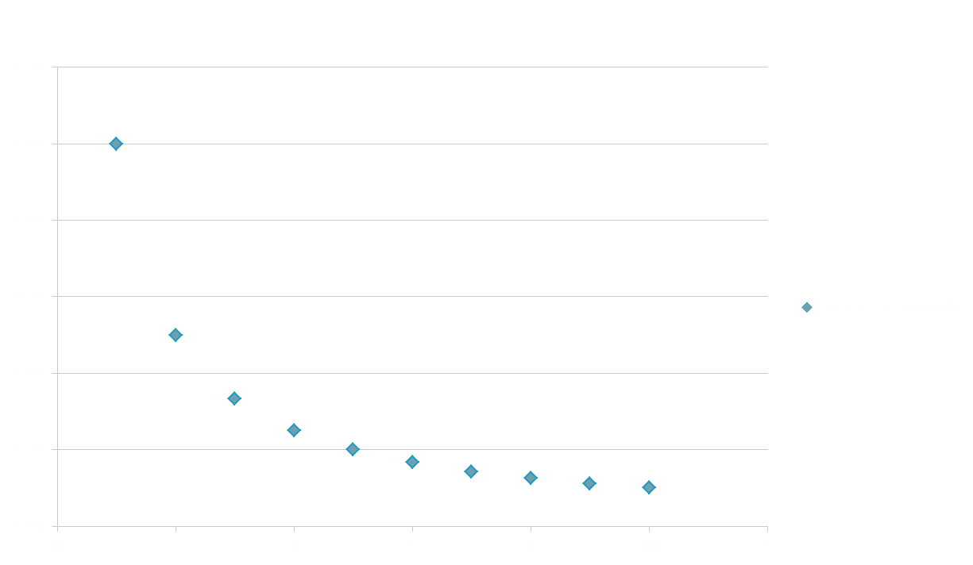
Benefits of group Downloading
Benefits are optimized for small group sizes
People vs Possible Benefit:
2=50%
5=80%
10=90%

